Slide 1
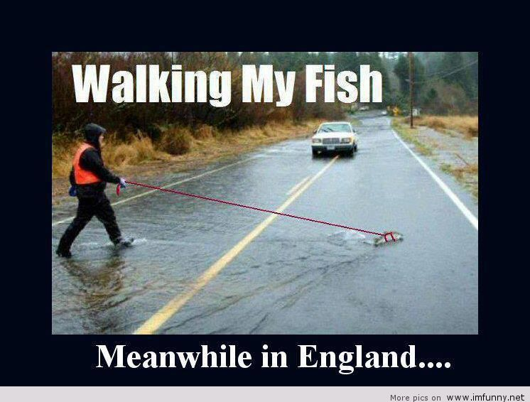
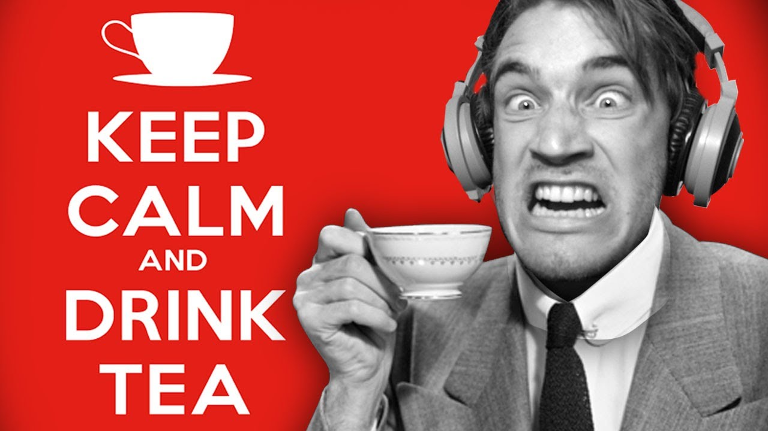
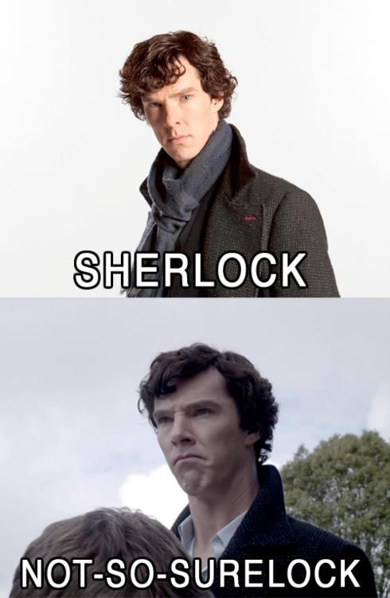
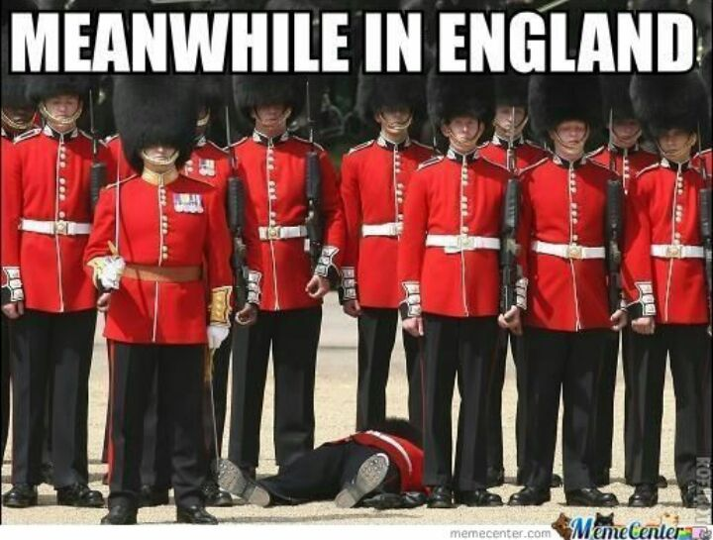
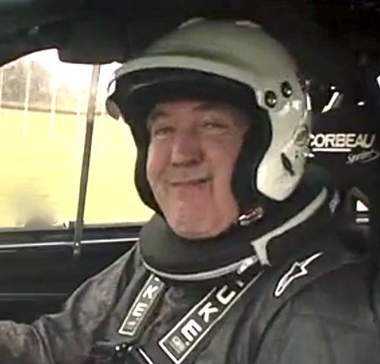
ENGLAND

Slide 2
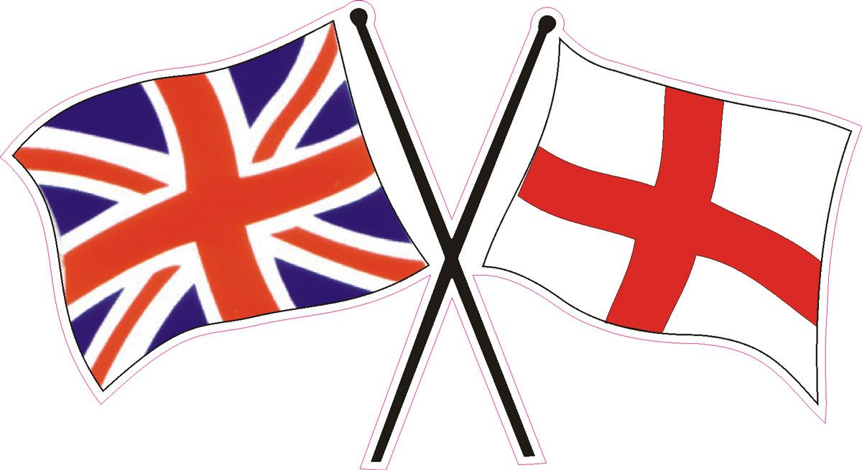
BASIC INFORMATIONS
England is one of 3 UK’s countries placed in the west part of Europe. The capital is London. There’s a queen Elizabeth II and royal family but Prime Minister, Boris Johnson, is the one who runs the country. The poplulation is over 55 milion of people. The biggest cities are London, Manchester, Sherffield, Birmingham, York and many more.

Slide 3
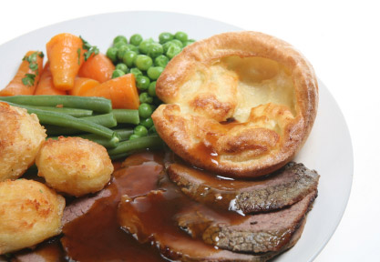
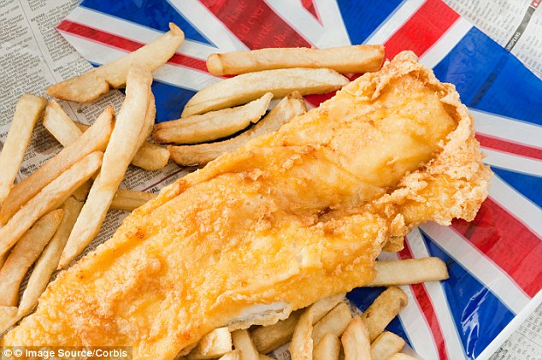
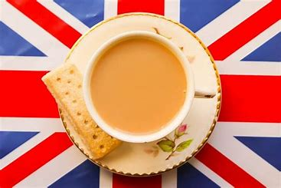
NATIONAL FOODS
There are few national english foods:
Beef
Pudding
Roast
Mash potatoes
Tea with milk
And of course world’s famous Fish and chips

Slide 4
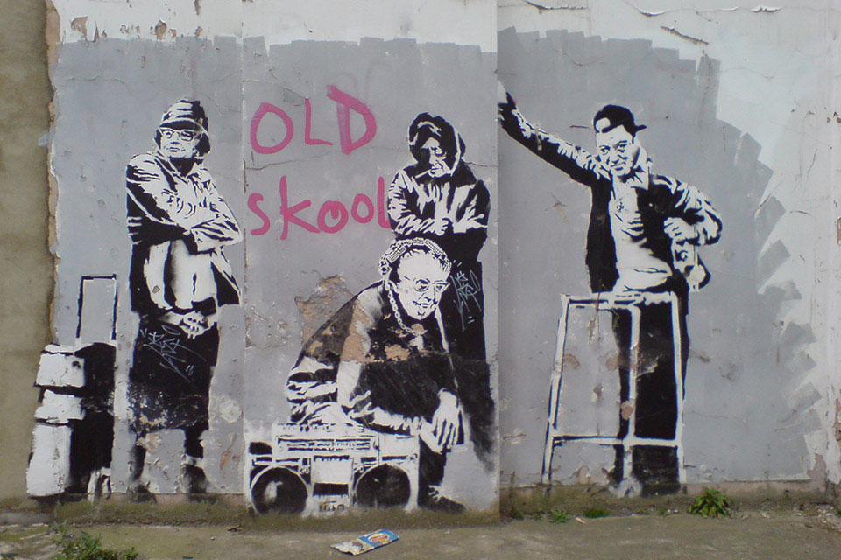
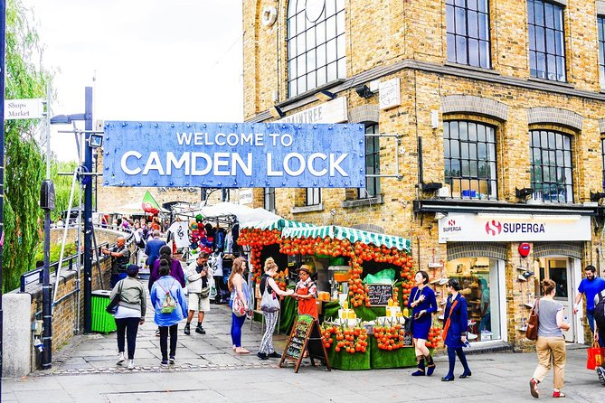
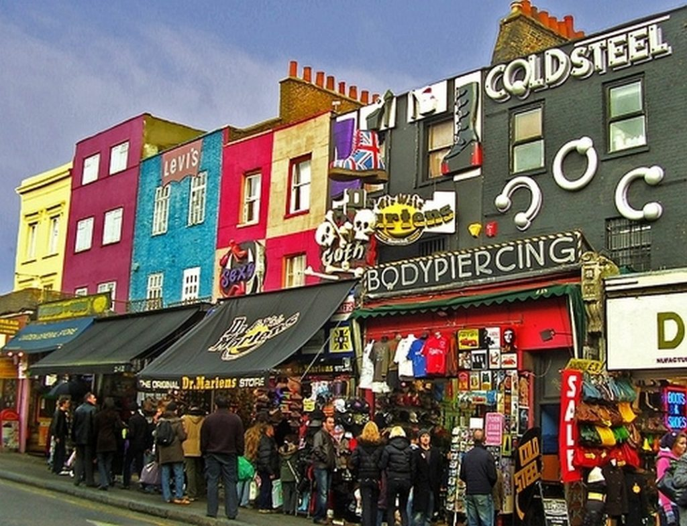
A PIECE OF MUSIC, ART AND FUN
Camden Town is the most colourful and amazing place in the world. There’re a lot of pubs, restaurants, topic shops, different market squares murals including Banksy’s ones.

Slide 5
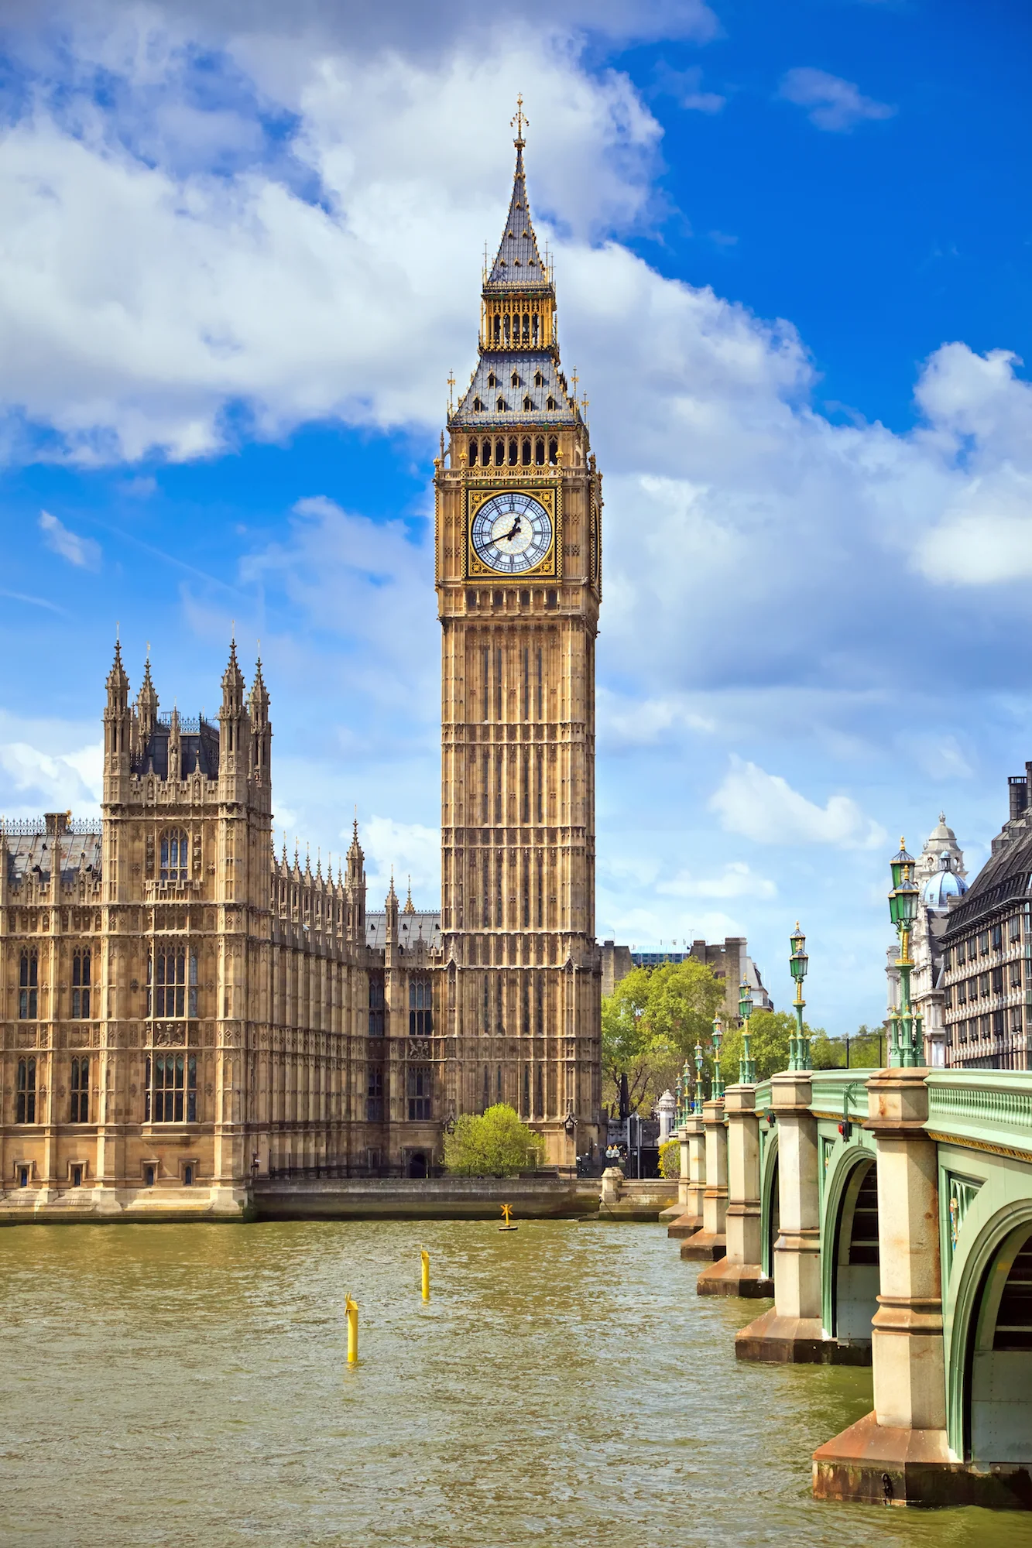
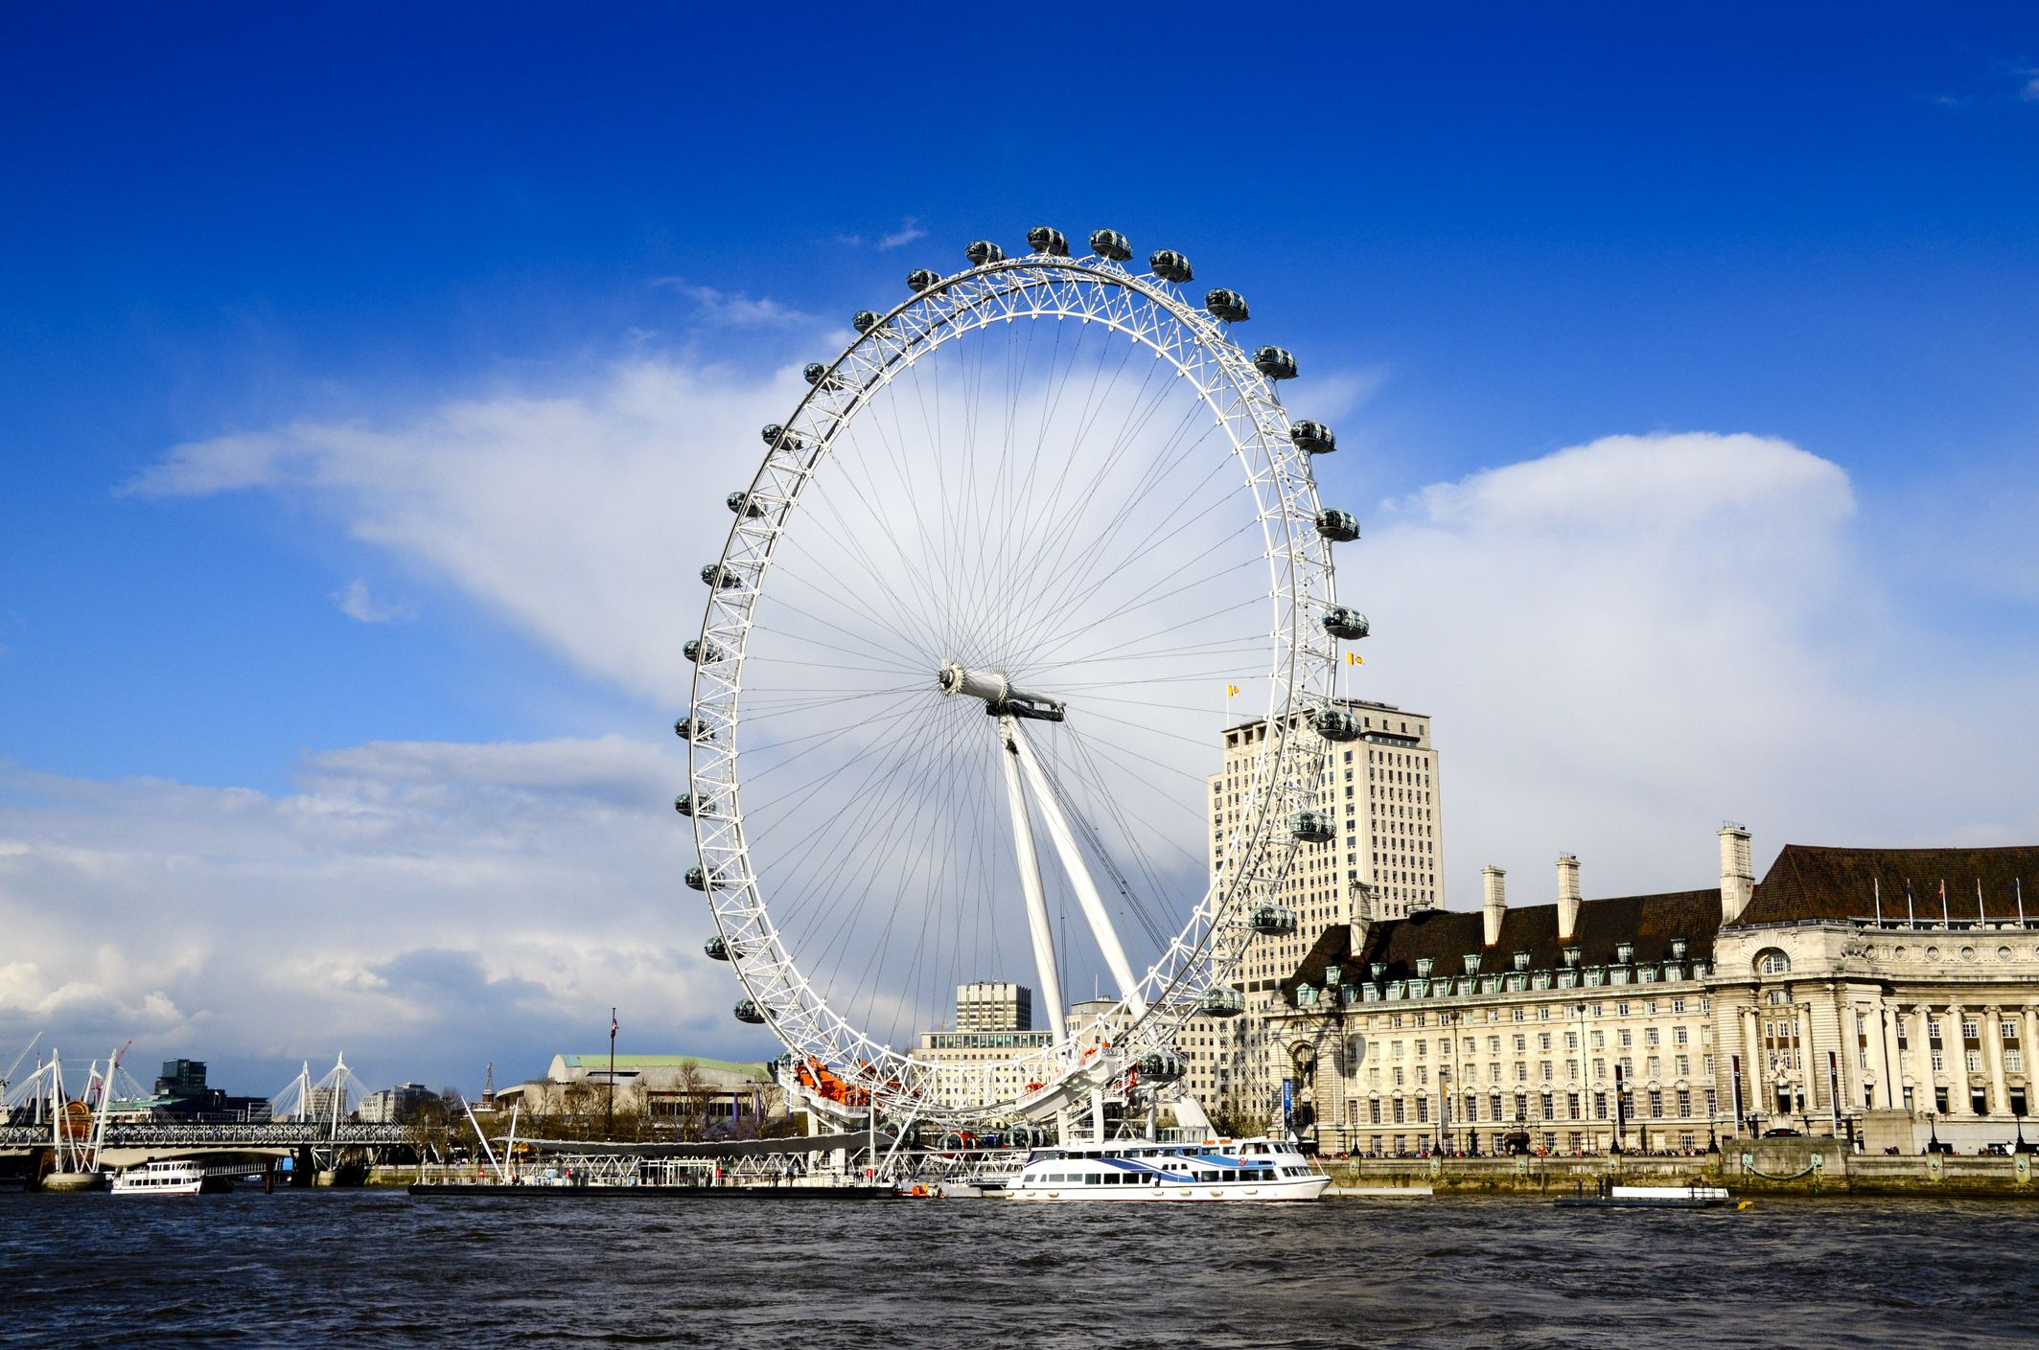
FAMOUS BUILDINGS
BIG BEN
LONDON EYE
Big Ben is a clock tower in Westminister, London. It’s 96 meters hight and it has 11 floors! It was built in 1843 but opened in 1859. Did you know that ’Big Ben’ is name of the bell inside the tower, not the clock?
also called Millenium Wheel is an observation wheel in London on the South Bank of the River Thames. It was opened it 1999, it costed 70 million British Pounds. The height is 135 meters. London eye is one of must- see London’s highlights

Slide 6
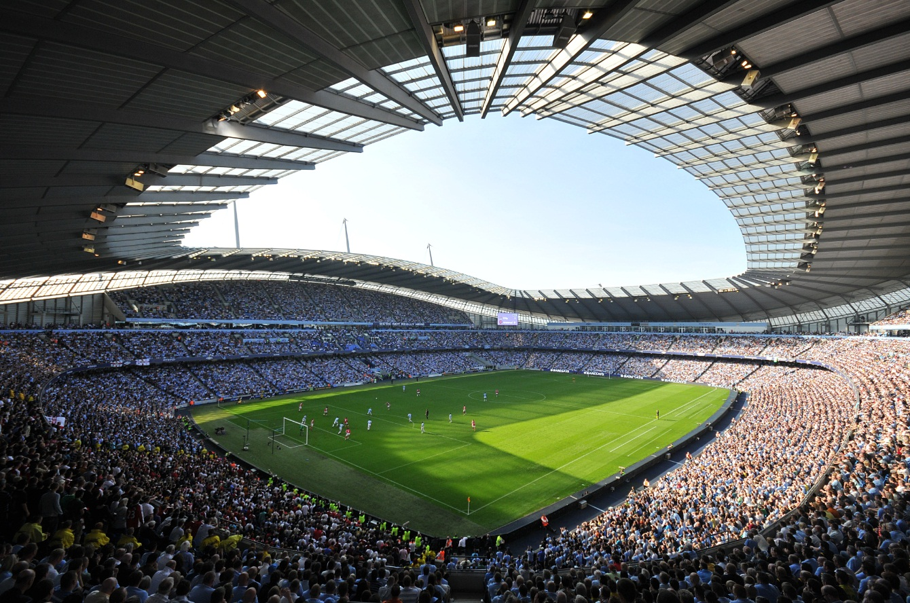
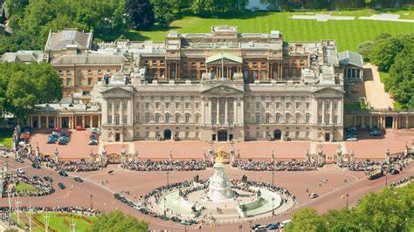
BUCKINGHAM PALACE
MANCHESTER STADIUM
Buckingham Palace is the residence of british royal family. It’s placed in London.
Fun facts:
Queen Victoria was the first royal to live at Buckingham Palace
The palace is full of masterworks of art.
There are over 700 rooms there
It’s football stadium in Manchester, home of Manchester United. The field size is 105 by 68 meters. It was first opened in 1910

Slide 7
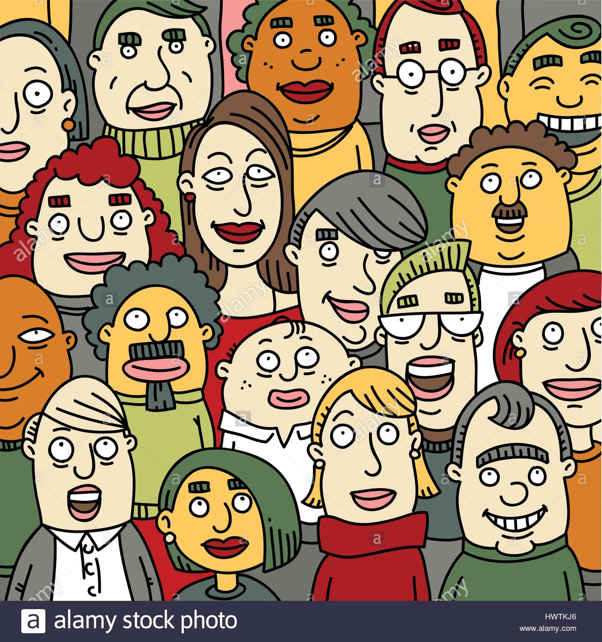
FAMOUS ENGLISH PEOPLE
Winston Churchill
Sherlock Holmes
William Shekspire
Arthur Conan Boyle
J.K Rowling
J.R.R Tolkien
Diana Spencer
Isaac Newton
The Beatels
James Cook

Slide 8
FAMOUS ENGLISH PEOPLE
Robert Baden- Powell
Margaret Thatcher
Stephen Hawking
David Bowie
Charles Dickens
Freddie Mercury
Charle Chaplin
Tony Blair
James Watt
Jeremy Clarkson

Slide 9
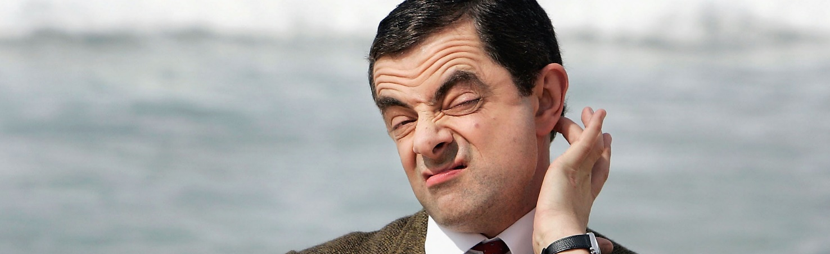
FUN FACTS!
Every year there are over 20 million turists come to England
First phone book was edited in England. There was 25 surnames in it
The English are obssesed with british royal family
There’s no constitucion in UK. People use Magnacarta- collection of documents which is treated like a constitucion
England is 74 times smaller than USA but 1,5 time more crowded than California
First metro was invented in London

Slide 10

Made in Poland by Hanna Kasperek VIIIb

