Slide 1

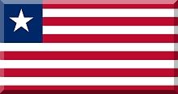
Curiosities of the English-speaking country
LIVERY
Prepared by: Samuel Kubik kl.6c

Slide 2
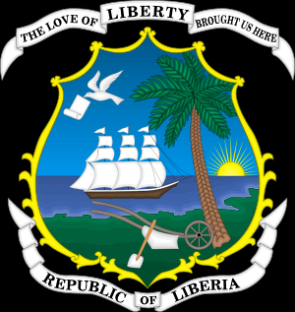
Liberia is a country located in West Africa
Official language : English
Capital city : Monrovia
Political system: Republic
Monetary unit: Liberian dollar
The state is divided into 15 counties

Slide 3
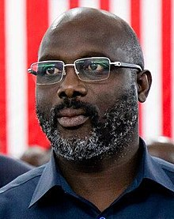
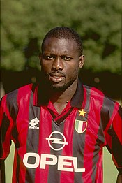
George Weah
George Manneh Oppong Weah (born 1 October 1966) is a Liberian politician and former professional footballer currently serving as the 25th President of Liberia, in office since 2018. Known for his humanitarian activities, he was the UNICEF Goodwill Ambassador.

Slide 4
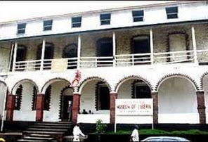
Liberian National Museum
The National Museum of Liberia is a national museum in Monrovia, Liberia. Initially housed in the First Executive Mansion on Ashmun Street of the city which is now used as a library, it was established by an Act of the National Legislature in 1958 under the administration of Liberia's 18th President, Dr. William V.S. Tubman. Its primary goal was to obtain, preserve and display cultural artefacts and other historical items which depict the country's heritage. its primary goal was to obtain, preserve and display cultural artefacts and other historical items which depict the country's heritage.

Slide 5
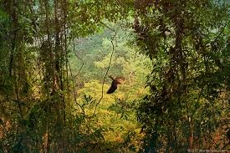
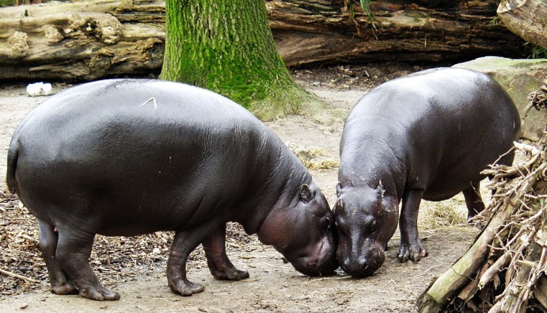
Sapo National Park
Sapo National Park is a national park in Sinoe County, Liberia. It is the country's largest protected area of rainforest and its only national park, and contains the second-largest area of primary tropical rainforest in West Africa. Sapo National Park is a regional centre of endemism and biodiversity at one time hosting around 125 mammal species and 590 types of bird. Sapo National Park contains the largest pygmy hippopotamus populations in Liberia.

Slide 6
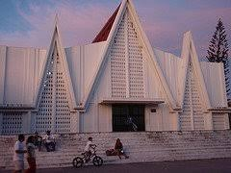
Sacred Heart Cathedral, Monrovia
It is a temple that serves as the headquarters of the Metropolitan Archdiocese of Monrovia (Archidioecesis Monroviensis) that was created on December 19, 1981 by Pope John Paul II by the bull Patet Ecclesiae.

Slide 7
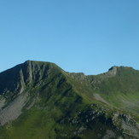
Mount Wuteve
Mount Wuteve is a mountain located in Liberia, whose summit is the highest point in Liberia. It is located in the Guinea Highlands range, whose parent range is the West Africa Mountains. Data from the Shuttle Radar Topography Mission reveals that the correct elevation of its summit is 1,440 meters, and not the previously quoted 1,380 meters.

Slide 8
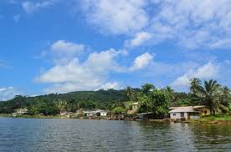
Lake Piso
Lake Piso, also known as Lake Pisu and Fisherman's Lake, is an oblong tidal lagoon in Grand Cape Mount County in western Liberia, near the town of Robertsport. At an area of 103 km², it is the largest lake in Liberia. Its name originates from a local term meaning "pigeon's hole" – a reference to the flocks of pigeons that once came to Lake Piso for water.

Slide 9
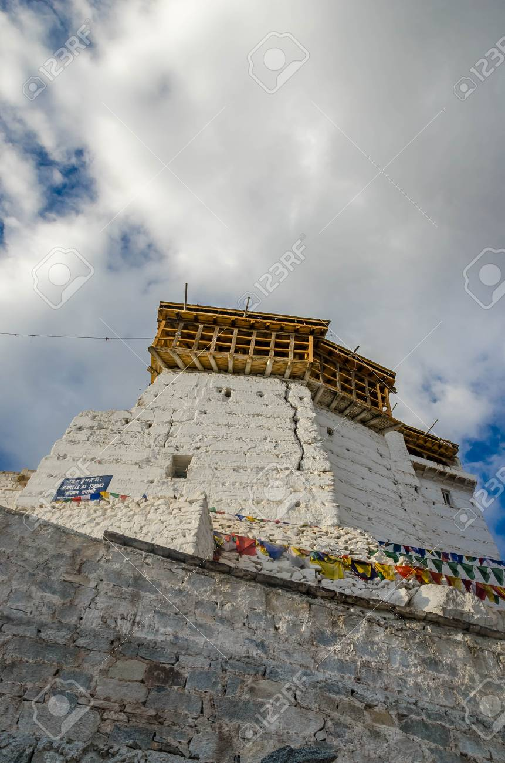
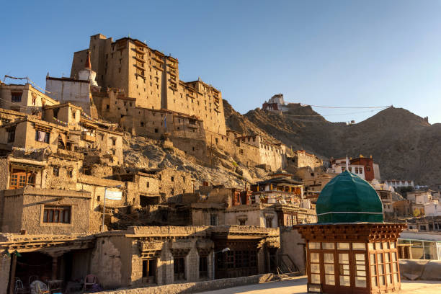
Ganta
Ganta is a busy city in the mountainous highlands and there is also a mosque.

Slide 10
Sources:
1. Geography of the countries of the
world Collective study
2. Wikipedia
3.100 countries 50,000 ideas Labor day
work Publisher: Olesiejuk
4. National Geographic series

